Slide 2
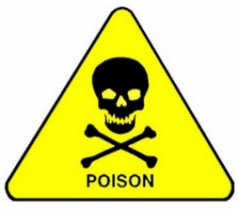
Pesticides (II)
By
Abeer Abdelwahab Sharaf-Eldin
Professor of Forensic Medicine and Toxicology
Benha Faculty of Medicine

Slide 3
Learning objectives
By the end of this presentation, participants should be able to:
Describe the symptoms of patients presenting with pesticides poisoning.
Explain the mechanisms of toxicity for pesticides.
Explain the mechanisms of action for atropine and pralidoxime.
Recommend a pharmaco-therapeutic regimen for patients presenting with pesticides poisoning.

Slide 4
Organic chlorines insecticides

Slide 5
It was developed as
Inexpensive
non-volatile.
environmentally stable
low acute toxicity.

Slide 6
However, the properties that made them effective insecticides also made them environmental hazards. These properties include slow metabolism, lipid soluble, chemical-stable. Persist in environment and accumulate.

Slide 7
Examples: DDT, aldrin, endrin and toxaphene. DDT is still widely used for malaria control programs in many countries. Organic chlorines are absorbed from the gut, by the lungs and across the skin in varying degrees.

Slide 8
Mechanisms of toxicity
1-They affect the neuronal membrane by either by:
interfering with repolarization, by prolonging depolarization.
impairing the maintenance of the polarized state of the neuron.
The end result is hyper-excitability of the CNS and repetitive neuronal discharge.

Slide 9
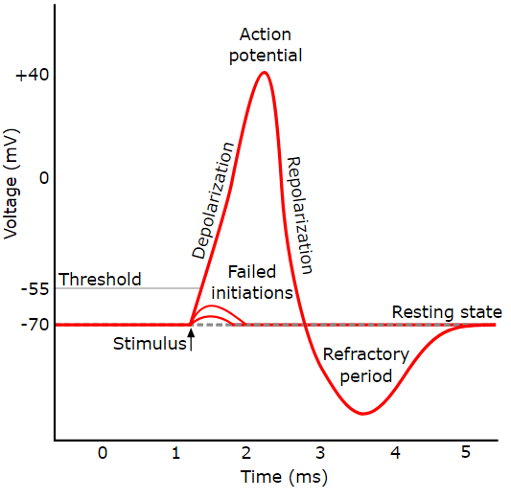

Slide 10
2-Some of them act a gamma- aminobutyric (GABA) antagonists leading to removal of inhibitory influences.
3-Organic-chlorins sensitize the myocardium to endogenous catecholamine and produce dysrhythmias.

Slide 11
Clinical manifestations
1-Nausea and vomiting.
2-Parethesia of face, tongue and extremities.
3-Headache, dizziness, agitation and confusion.
4-Myoclonus and leg weakness.
5-Tremors (may be the initial manifestation), seizures, respiratory failure and death.

Slide 12
Treatment
1-The organic chlorines are all neurotoxins, so, the risk of complication associated with seizures probably over-weights the risk of any GIT contamination strategies.
2-Stabilization.
3-Seizures should be controlled with benzodiazepines followed by pentobarbital and neuromuscular blockade.
4-Hyperthermia: external cooling is needed.

Slide 13
Pyrethrins and Pyrethroids Sources and forms of toxins

Slide 14
Pyrethrum is a natural compound extracted from the chrysanthemum flower. Pyrethrum contains six active compounds called pyrethrins.
Pyrethroids are synthetic derivatives of the pyretherins. Many of these compounds are mixed in petroleum distillates which can produce a hydrocarbon chemical pneumonitis.
These agents are used commonly as aerosols in automated insect spray in public places; therefore, inhalation is the most common source of exposure.

Slide 16
Mechanism of toxicity
*Pyrethroids prolong the inactivation of the sodium channel by binding to it in the open state.
*These compounds produce cutaneous and inhalational allergic reactions.

Slide 17
Clinical presentation
1-skin: erythema, vesiculation and mild paresthesias.
2-Pulmonary: upper airway irritation (rhinitis, throat irritation, oral and laryngeal edema) and lower airway reactions (cough, wheezing and chest pain).
3-GIT: nausea, vomiting, diarrhea and abdominal cramping can occur with both oral and inhalational exposure.
4-Neurological: CNS excitation, tremors, incoordination and paralysis. Seizures may occur with massive ingestion.
Laboratory tests: no specific laboratory tests are indicated.

Slide 18
Management
1-Removal from exposure.
2-The patient usually not needs hospitalization.
3-Supportive therapy: should be administered based on the symptoms and signs. Vitamin E oil applied dermally to relieve paresthesia.
4-GIT decontamination: is not indicated unless the patient ingested more than 1 g/kg of the poison. If GI emptying is indicated, either emesis or lavage, the placement of a cuffed endotracheal tube is necessary.
5-No specific antidotal therapy.

Slide 20
Rodenticides
Rodenticides are defined as any substance that is used to kill rats, mice, and other rodent pests.
It may be classified in several ways but the most medically useful of classifying them is by toxicity.

Slide 21
1-Highly toxic rodenticides include: thallium, sodium monofluoroacetate, strychnine, zinc phosphide, yellow phosphorus and arsenic.
2-Moderately toxic rodenticides includes: α-naphthyl-thiourea and cholecalciferol (vitamin D3).
3-Low toxic rodenticides includes: red squill and warfarine-type anticoagulants.

Slide 22
Anticoagulant rodenticides
The toxicity of anticoagulant rodenticides depends entirely on repeated exposure to relatively small doses.
All the anticoagulant rodenticides act by interfering with the synthesis of vitamin K which is essential for normal blood coagulation.
Hemorrhage is the most frequent encountered complication from anticoagulant poisoning.

Slide 23
Warfarin poisoning can cause spontaneous bleeding, usually from the nose, gums as well as the gastrointestinal and urinary tracts.
Hemorrhage into the skin and brain can also occur, but this is less common.
Treatment consists of activated charcoal and vitamin K1 orally at a dose of 5 mg in children and 20 mg in adults two or four times daily.

Slide 24
Zinc Phosphide
Mechanism of toxicity:
The toxicity of zinc phosphide results from the liberation of phosphine gas when it ingested following a hydrolytic reaction with water an ai in the stomach.

Slide 25
Phosphine gas (which is a cytochrome C oxidase inhibitor) acts rapidly to cause
Widespread cellular toxicity.
Necrosis of the gastrointestinal tract.
Injury to liver and kidney if ingested.
Injury to the lungs if inhaled.

Slide 26
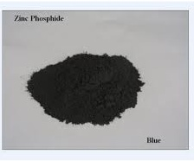

Slide 27
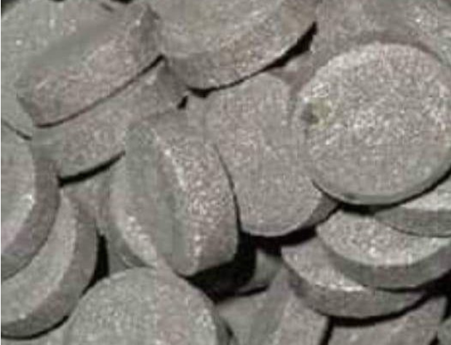

Slide 28
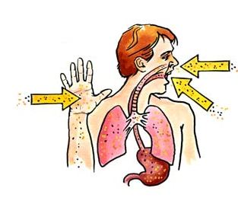

Slide 29
Clinical picture
C.N.S.: Headache, fatigue, ataxia, seizures and coma .
G.I.T.: Nausea, vomiting (black vomitus), epigastric pain with a fishy breath. The symptoms are due to GI irritation or ulceration.
Hepatic: Centrilobular necrosis (hepatic), jaundice.
C.V.S: Shock and dysrhythmia.
Respiratory: Non-cardiogenic pulmonary edema, cough, dyspnea.
Neuromuscular & skeletal: Paresthesias and intention tremors.
Ocular: Diplopia.
Endocrine & metabolic: Metabolic acidosis, hypocalcemia and tetany.

Slide 30
Zinc Phosphide affects all cells but Targets Cells in Heart, Lung and Liver so, Its main effects are Metabolic Acidosis Hepatotoxicity cardiotoxicity

Slide 31
Diagnosis
History and clinical picture.
Investigations:
ECG, ABG and liver functions.

Slide 32
Treatment:
The management of zinc phosphide poisoning is mostly supportive and symptomatic.

Slide 33
Thank you

